Slide 2
Making the Most of Your Advisory Council
Andrea Welker, The College of New Jersey
Kemper Lewis, The University at Buffalo - SUNY
Nancy Warter-Perez, California State University Los Angeles

Slide 3
Goals
GATHER BASELINE INFORMATION ON ADVISORY COUNCILS
SHARE BEST PRACTICES AND LEARN FROM EACH OTHER
PLAN AND SHARE ONE ENGAGEMENT STRATEGY

Slide 4
Models
Advisory
Philanthropic
Advocacy
Chair
Authority
By-laws

Slide 5
Approach
Polling using Poll Everywhere
Three ways to join
Go to this website: PollEv.com​/andreawelker363
Text: andreawelker363 to 22333
Scan the QR code on the right corner of the screen
Next poll will automatically load
We will share the results with all of you after the event
You can change answers or delete your answer using the little trashcan icon
Work in groups
Finish up with two more polls

Slide 6
Notes:
Do not modify the notes in this section to avoid tampering with the Poll Everywhere activity. More info at polleverywhere.com/support How big is your advisory council?
https://www.polleverywhere.com/multiple_choice_polls/BkqoCiaQNqpIjaVs5QlK9?state=opened&flow=Default&onscreen=persist

Slide 7
Notes:
Do not modify the notes in this section to avoid tampering with the Poll Everywhere activity. More info at polleverywhere.com/support My council has guidance documents (e.g. by-laws)
https://www.polleverywhere.com/multiple_choice_polls/IJz285RJj38va1NfKI6sE?state=opened&flow=Default&onscreen=persist

Slide 8
Notes:
Do not modify the notes in this section to avoid tampering with the Poll Everywhere activity. More info at polleverywhere.com/support What is the primary function of your advisory council?
https://www.polleverywhere.com/multiple_choice_polls/ZEuMmEsBsMCbbmIv4fb7H?state=opened&flow=Default&onscreen=persist

Slide 9
Notes:
Do not modify the notes in this section to avoid tampering with the Poll Everywhere activity. More info at polleverywhere.com/support Who is on your advisory council? (select all that apply)
https://www.polleverywhere.com/multiple_choice_polls/zxC2uVBmK5RAisHsG4PbR?state=opened&flow=Default&onscreen=persist

Slide 10
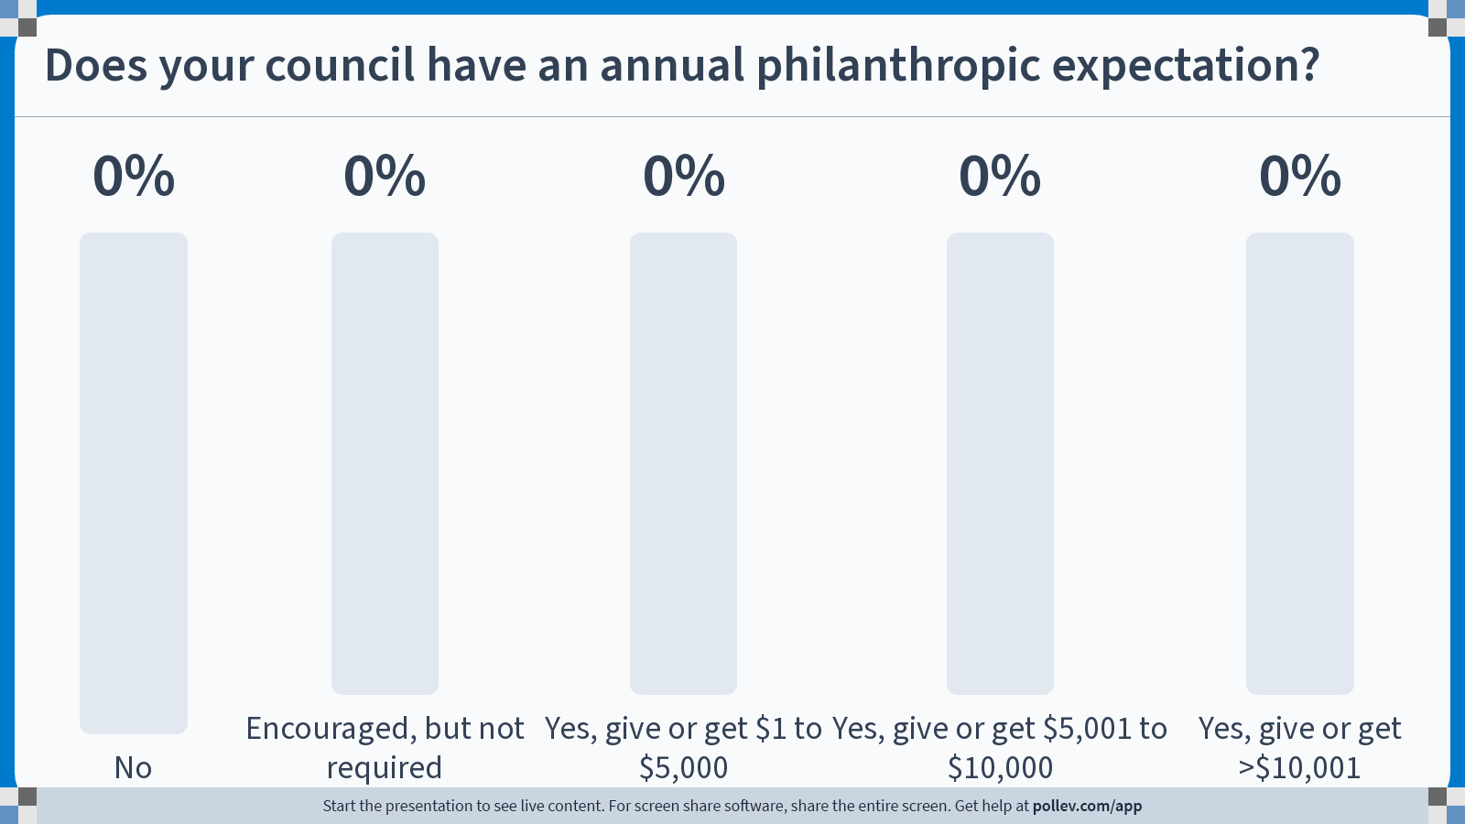
Notes:
Do not modify the notes in this section to avoid tampering with the Poll Everywhere activity. More info at polleverywhere.com/support Does your council have an annual philanthropic expectation?
https://www.polleverywhere.com/multiple_choice_polls/sHLleUeBPaOiZKxbYNeyg?state=opened&flow=Default&onscreen=persist

Slide 11
Notes:
Do not modify the notes in this section to avoid tampering with the Poll Everywhere activity. More info at polleverywhere.com/support Use single words to describe some of the strengths of your council (more than one response allowed)
https://www.polleverywhere.com/free_text_polls/4ajPbyY7PWc9f9wEDaEbK

Slide 12
Notes:
Do not modify the notes in this section to avoid tampering with the Poll Everywhere activity. More info at polleverywhere.com/support How often does your council meet?
https://www.polleverywhere.com/multiple_choice_polls/9CYZfb1HjnbMUFYmJw8jU?state=opened&flow=Default&onscreen=persist

Slide 13
Notes:
Do not modify the notes in this section to avoid tampering with the Poll Everywhere activity. More info at polleverywhere.com/support Briefly describe the format of your meetings
https://www.polleverywhere.com/free_text_polls/PUjK0hGFOMiwckzNVLuas

Slide 14
Notes:
Do not modify the notes in this section to avoid tampering with the Poll Everywhere activity. More info at polleverywhere.com/support How effective was your last meeting?
https://www.polleverywhere.com/multiple_choice_polls/plCBpL3wBIzdbh2cUi2n2?state=opened&flow=Default&onscreen=persist

Slide 15
Breakout #1
With the folks at your table, spend about 15 minutes discussing the following questions.
Record your answers on the sheet on your table. Pick someone who will be willing to report out.
What is the best thing about the configuration of your council?
What is one thing you wish was better about your council?
Do you think your council has enough context about higher education to meaningfully contribute?

Slide 16
Breakout #2
With the folks at your table, spend about 15 minutes discussing the following questions.
Record your answers on the sheet on your table. Pick someone who will be willing to report out.
What do you hope to accomplish at your next advisory council meeting?
What is one thing you could do to better engage your council?

Slide 17
Notes:
Do not modify the notes in this section to avoid tampering with the Poll Everywhere activity. More info at polleverywhere.com/support What is one strategy that you will implement to better engage your council?
https://www.polleverywhere.com/free_text_polls/qrErQNNZcCHgRbdmavT52

Slide 18
Notes:
Do not modify the notes in this section to avoid tampering with the Poll Everywhere activity. More info at polleverywhere.com/support What is something that resonated with you from our session today?
https://www.polleverywhere.com/free_text_polls/xfo6WNXQnLdz9s8fGTgIs

Slide 19
Thank you!
We will be sharing these results with you…

